Slide 1
Accessibility
Identify the vulnerable populations to consider
Discuss requirements for accessibility and other special needs

Slide 2
Historic Fire
L’Isle Verte

Slide 3
Mobility Impairments
Must accommodate everyone
All occupants not intimate with fire shall be kept safe

Slide 4
IBC Chapter 10
Four or more floors
Elevator
No exit access stairs
Stairs 48” between handrails
Normal with sprinklers
Area of refuge

Slide 5

IBC Chapter 11
Not all areas
Work areas where change in elevation is essential
No elevators
Not all routes
One
Site plan
60 % of entrances
General circulation

Slide 6
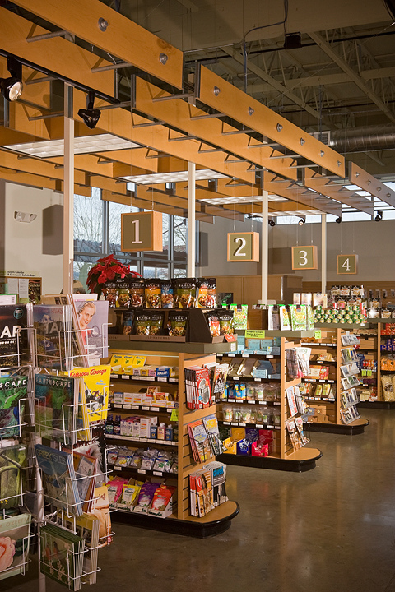
IBC Chapter 11
Parking spaces
Hospital sleeping rooms
Hotel rooms
Apartments
Assembly seating areas
Self-service storage
Bathrooms
Check-out aisles
Recreation facilities

Slide 7
International Codes
https://assets.publishing.service.gov.uk/government/uploads/system/uploads/attachment_data/file/441786/BR_PDF_AD_M2_2015.pdf

Slide 8
Vulnerable Populations
Movement impaired
Visually impaired
Hearing impaired
Cognitive disability
Elderly
Children
Large groups
Isolation
Unfamiliar
Asleep
Intoxicated
Non-Native speakers
Committed to task
Situationally disabled
Compounded effects

Slide 9
Code Requirements
Combination horn/strobe
520 Hz smoke alarms
Voice alarms?
Area of refuge
Occupant evacuation elevators
Assistive listening systems
Stair markings?
Signage

Slide 10
Future
Increased occupant evacuation elevators
Stairway descent devices
Multi sensorial wayfinding
Personalized emergency messaging
?

